Slide 1

Saint Mary’s Catholic Voluntary Academy
Key Stage 1 National Curriculum
Assessments
Information and Guidance

Slide 2
click to see all text
Key Stage 1 National Curriculum Assessment
In 2014/15 a new national curriculum framework was introduced by the government for Years 1, 3, 4 and 5.
However, Years 2 and 6 (due to statutory testing) continued to study the previous curriculum for one further year.
In 2015/16 children in all years at Key Stage 1 and 2 are expected to now study the new national curriculum.
KS1 (Year 2) and KS2 SATs (Year 6) will reflect the new curriculum for the first time this year.
Children in Year 2 and 6 are required to take part in end of key stage assessments known as SATs.
This PowerPoint will take you through the process and hopefully answer some questions you may have.
next page

Slide 3
click to see all text
Assessment and Reporting
‘Old’ national curriculum levels (e.g. Level 3, 4, 5) have now been abolished, as set out in the government guidelines.
From 2016, test scores will be reported as ‘scaled scores’.
This means it is very difficult to compare the assessment of a previous year with the current year.
Your child will still be taught with the highest expectations and cover all required elements of the curriculum, similar to previous years.
The new curriculum is more rigorous and sets high expectations which all schools have had to work hard to meet since the beginning of last year.
What is meant by ‘scaled scores’?
From 2016, test scores have been reported as ‘scaled scores’.
Tests are developed to the same specification each year, however, because the questions must be different, the difficulty of tests may vary slightly each year. This means we need to convert the total number of marks a pupil gets in a test (their ‘raw’ score) into a scaled score, to ensure we can make accurate comparisons of pupil performance over time.
Each pupil’s raw test score will therefore be converted into a score on the scale, either at, above or below 100.
next page

Slide 4
click to see all text
Scaled Score Examples
On publication of the test results in July 2016:
A child awarded a scaled score of 100 is judged to have met the ‘national standard’ in the area judged by the test.
A child awarded a scaled score of more than 100 is judged to have exceeded the national standard and demonstrated a higher than expected knowledge of the curriculum for their age.
A child awarded a scaled score of less than 100 is judged to have not yet met the national standard and performed below expectation for their age.
Marking guidance for KS1 tests will include conversion tables. Teachers will use these to translate pupil’s raw scores into scaled scores to see whether each pupil has met the national standard. Teachers will use the scaled scores to inform their teacher assessment judgements.
On publication of the test results in July 2022:
A child awarded a scaled score of 100 is judged to have met the ‘national standard’ in the area judged by the test.
A child awarded a scaled score of more than 110 is judged to have exceeded the national standard and demonstrated a higher than expected knowledge of the curriculum for their age.
A child awarded a scaled score of less than 100 is judged to have not yet met the national standard and performed below expectation for their age.
Teachers will use the scaled scores to inform their teacher assessment judgements.
next page

Slide 5
click to see all text
The Tests
At the end of Year 2, children will take assessments in:
Reading – short read and long read
Maths – arithmetic and reasoning
Grammar, Punctuation and Spelling- one spelling and one grammar test
Tests will be given the week commencing Monday the 15th of May. The children will take no more that two tests a day from Monday to Thursday and it will not be strictly timed.
The tests will take place in class so the children feel comfortable, most of the time the children are unaware that they are taking the official test. We will take practise tests prior to the actual tests to help inform our overall teacher judgements. We use previous SAT papers so it is important that children are
not exposed to these at home as it may skew the results.
The results from the test will be used alongside the work they have been doing in class throughout the year to help inform teacher judgement. This will be reported to parents in the end of year report.
At the end of Year 2, children will take SATS in:
Reading;
English grammar, punctuation and spelling;
Maths.
The tests are due to take place in May of each year.
next page

Slide 6
click to see all text
Reading
The Reading Test consists of two separate papers:
Paper 1 – Contains a selection of texts totalling between 400 and 700 words with questions about the text.
Paper 2 – Contains a reading booklet of a selection of passages totalling 800 to 1100 words. Children will write their answers to questions about the passage in a separate booklet.
Each paper should take approximately 30 to 40 minutes to complete, although the children are not being assessed at working at speed so will not be strictly timed.
The texts will cover a range of poetry, fiction and non-fiction.
Questions are designed to assess the comprehension and understanding of a child’s reading.
Some questions are multiple choice or selected response, others require
short answers and some require an extended response or explanation.
The Reading Test consists of two separate papers:
Paper 1 – Contains a selection of texts totalling between 400 and 700 words with questions about the text.
Paper 2 – Contains a reading booklet of a selection of passages totalling 800 to 1100 words. Children will write their answers to questions about the passage in a separate booklet.
Each paper is worth 50% of the marks and should take approximately 30 minutes to complete, although the children are not being assessed at working at speed so will not be strictly timed.
The texts will cover a range of poetry, fiction and non-fiction.
Questions are designed to assess the comprehension and understanding of a child’s reading.
Some questions are multiple choice or selected response, others require
short answers and some require an extended response or explanation.
next page

Slide 7
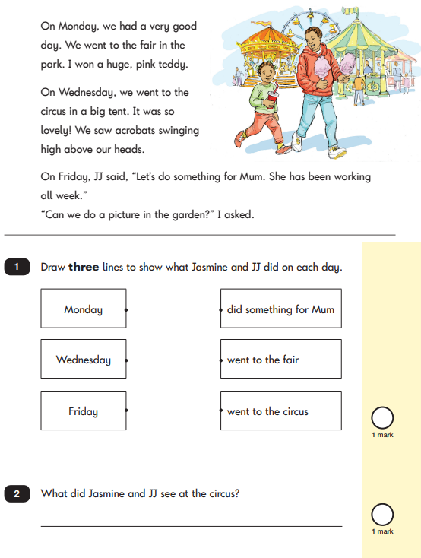
Sample Questions
Reading Paper 1
next page

Slide 8
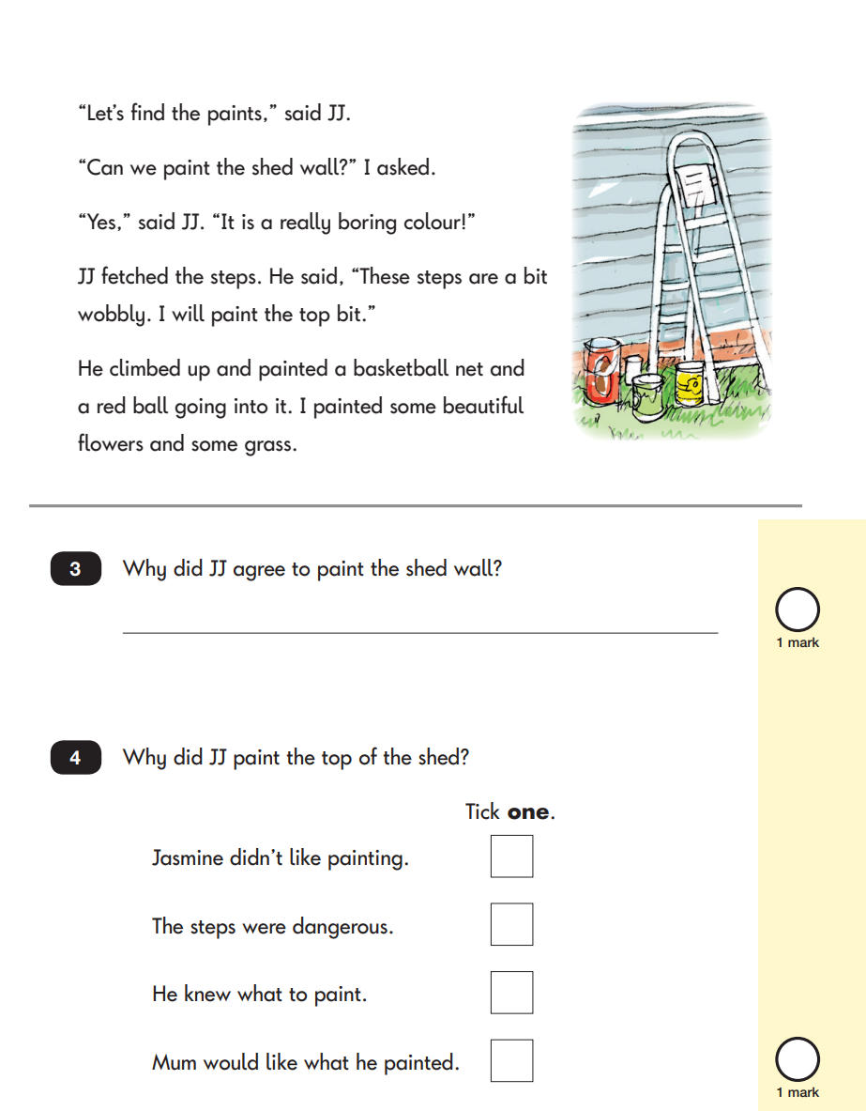
Sample Questions
Reading Paper 1
next page

Slide 9
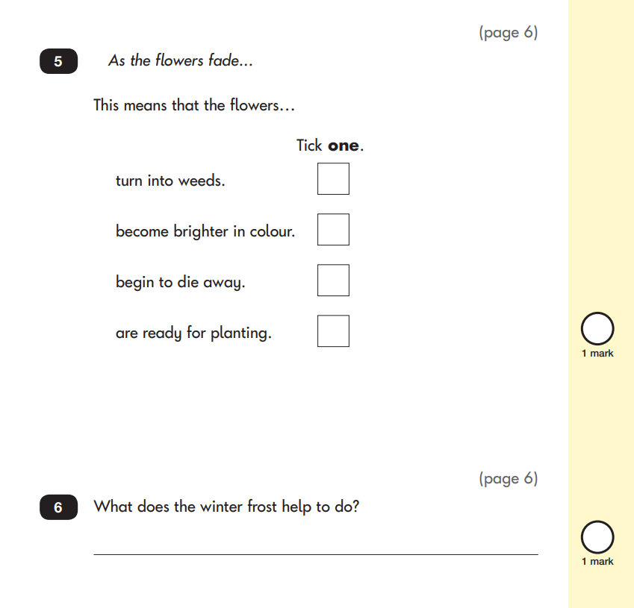
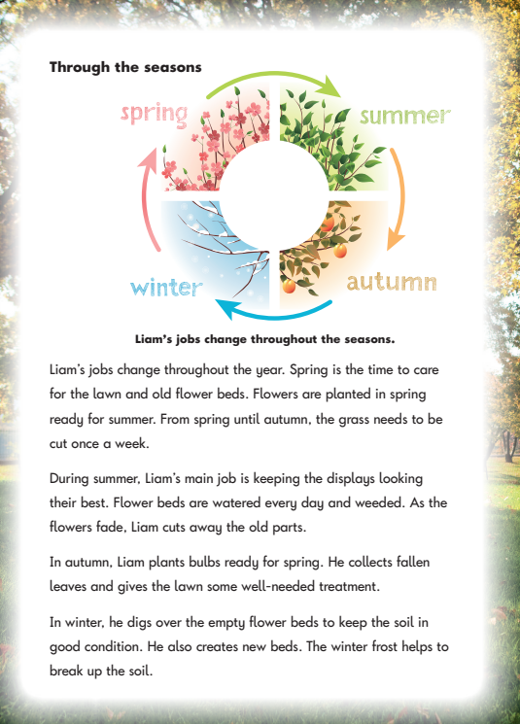
Sample Questions
Reading Paper 2
next page

Slide 10
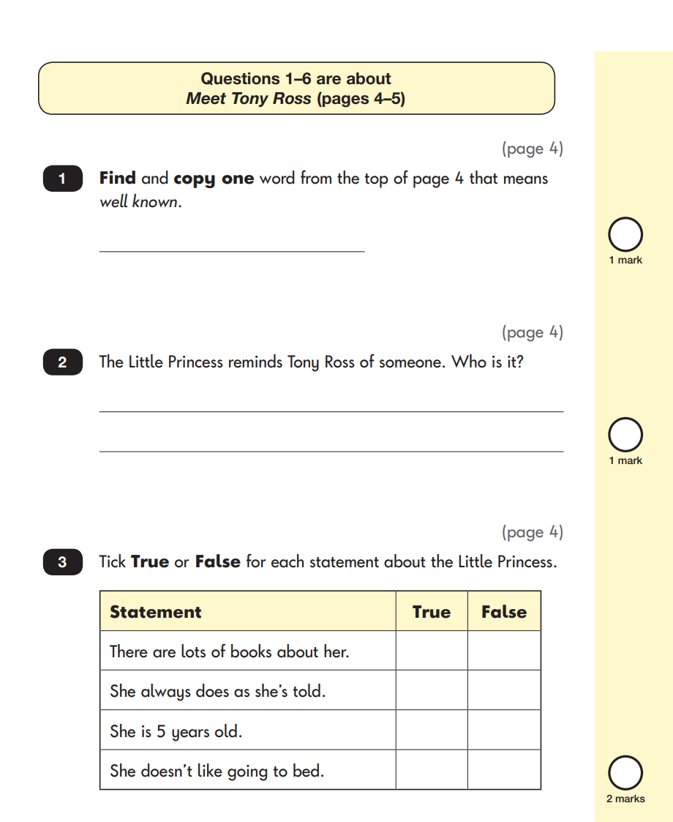
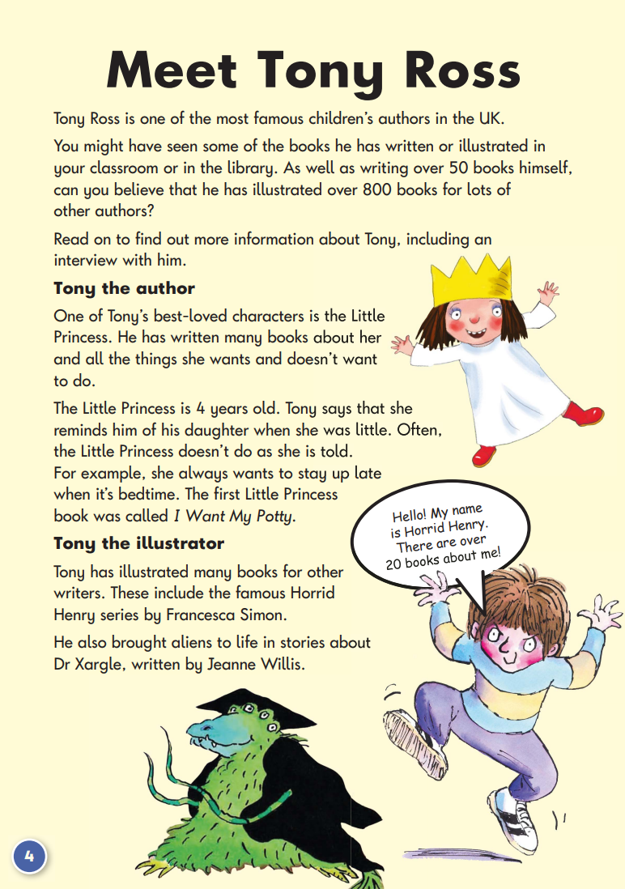
Sample Questions
Reading Paper 2
next page

Slide 11
click to see all text
Mathematics
Children will sit two tests: Paper 1 and Paper 2:
Paper 1 is for arithmetic, lasting approximately 25 minutes and worth 25 marks. It covers calculation methods for all operations.
Paper 2 covers problem solving, reasoning and mathematical fluency, lasts for approximately 35 minutes and is worth 35 marks.
Children will still require calculation skills and questions will be varied including multiple choice, matching, true/false, completing a chart or table or drawing a shape. Some questions will also require children to show or explain their working out.
Children will sit two tests: Paper 1 and Paper 2:
Paper 1 is for arithmetic, lasting approximately 25 minutes and worth 25 marks. It covers calculation methods for all operations.
Paper 2 covers problem solving, reasoning and mathematical fluency, lasts for approximately 35 minutes and is worth 35 marks.
Pupils will still require calculation skills and questions will be varied including multiple choice, matching, true/false, completing a chart or table or drawing a shape. Some questions will also require children to show or explain their working out.
next page

Slide 12
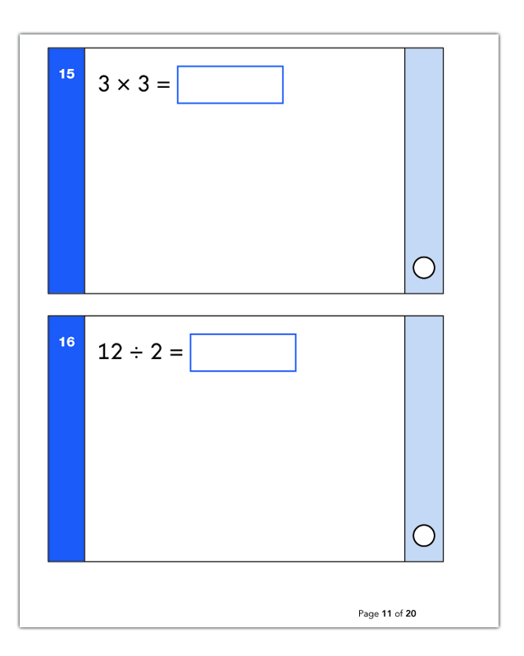
Sample Questions
Maths Paper 1: Arithmetic
next page

Slide 13
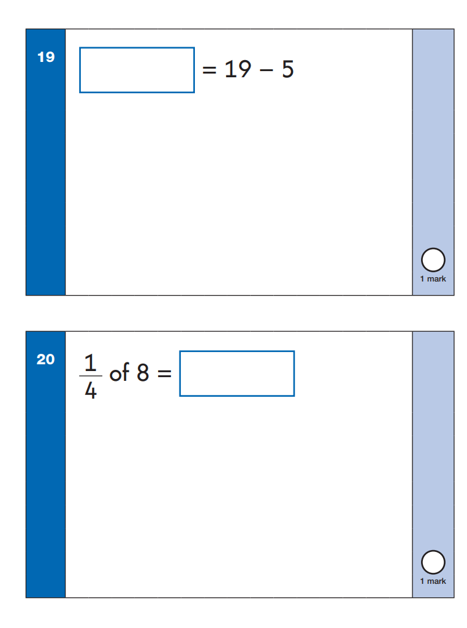
Sample Questions
Maths Paper 1: Arithmetic
next page

Slide 14
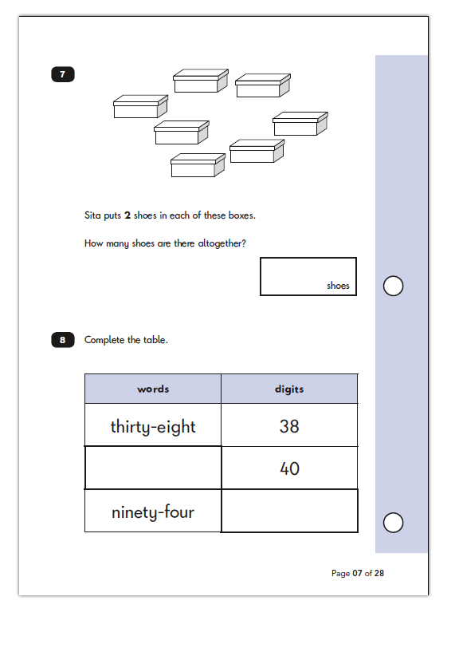
Sample Questions
Maths Paper 2: Reasoning
next page

Slide 15
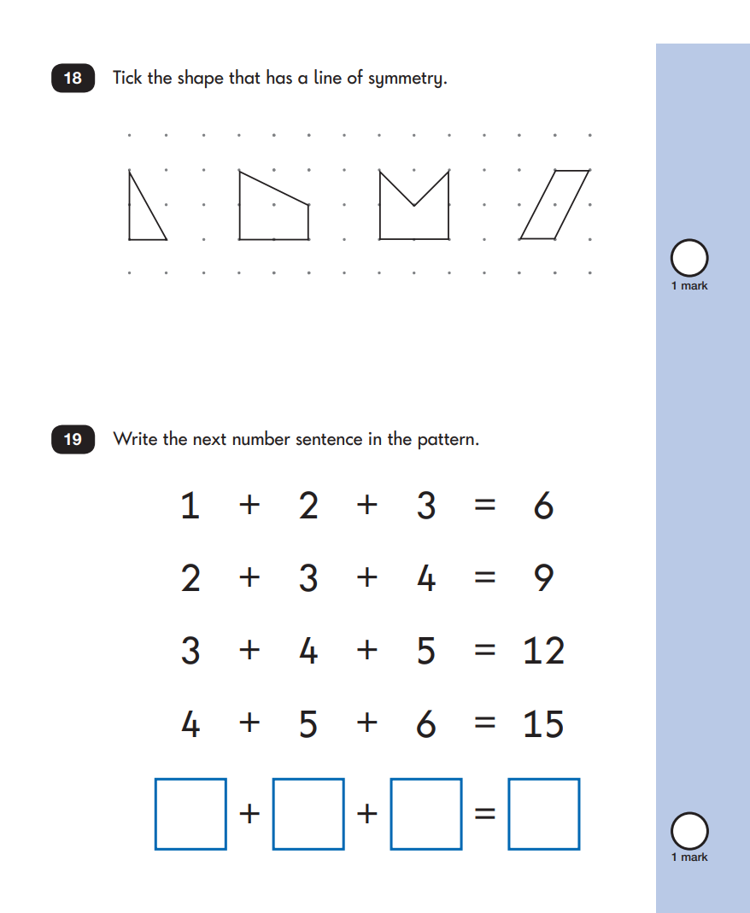
Sample Questions
Maths Paper 2: Reasoning
next page

Slide 16
click to see all text
Grammar, Punctuation and Spelling
This consists of two separate papers:
Paper 1 tests 20 spellings.
Words are read out for children to write in a blank space within a given sentence. Each word is read out, then repeated within the sentence.
The test should last approximately 15 minutes but is not strictly timed.
Paper 2 tests grammar and punctuation.
The test should take approximately 20 minutes but again is not strictly timed.
Children will need to have knowledge of sentence punctuation
. ! ? , ‘ ABC
word types (nouns, verbs, adverbs and adjectives),
sentence types (command, statement, question, exclamation)
Conjunctions
Tense
Vocabulary including prefixes and suffixes
The Reading Test consists of two separate papers:
Paper 1 – Contains a selection of texts totalling between 400 and 700 words with questions about the text.
Paper 2 – Contains a reading booklet of a selection of passages totalling 800 to 1100 words. Children will write their answers to questions about the passage in a separate booklet.
Each paper is worth 50% of the marks and should take approximately 30 minutes to complete, although the children are not being assessed at working at speed so will not be strictly timed.
The texts will cover a range of poetry, fiction and non-fiction.
Questions are designed to assess the comprehension and understanding of a child’s reading.
Some questions are multiple choice or selected response, others require
short answers and some require an extended response or explanation.
next page

Slide 17
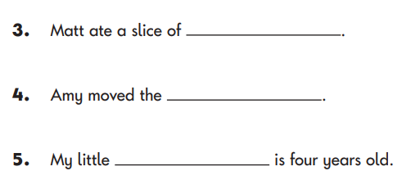
click to see all text
Grammar, Punctuation and Spelling
Grammar, Punctuation and Spelling Paper 1:Spelling
The Reading Test consists of two separate papers:
Paper 1 – Contains a selection of texts totalling between 400 and 700 words with questions about the text.
Paper 2 – Contains a reading booklet of a selection of passages totalling 800 to 1100 words. Children will write their answers to questions about the passage in a separate booklet.
Each paper is worth 50% of the marks and should take approximately 30 minutes to complete, although the children are not being assessed at working at speed so will not be strictly timed.
The texts will cover a range of poetry, fiction and non-fiction.
Questions are designed to assess the comprehension and understanding of a child’s reading.
Some questions are multiple choice or selected response, others require
short answers and some require an extended response or explanation.
next page

Slide 18
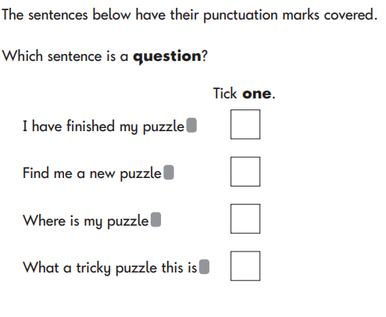
click to see all text
Grammar, Punctuation and Spelling
Grammar, Punctuation and Spelling Paper 2:Questions
The Reading Test consists of two separate papers:
Paper 1 – Contains a selection of texts totalling between 400 and 700 words with questions about the text.
Paper 2 – Contains a reading booklet of a selection of passages totalling 800 to 1100 words. Children will write their answers to questions about the passage in a separate booklet.
Each paper is worth 50% of the marks and should take approximately 30 minutes to complete, although the children are not being assessed at working at speed so will not be strictly timed.
The texts will cover a range of poetry, fiction and non-fiction.
Questions are designed to assess the comprehension and understanding of a child’s reading.
Some questions are multiple choice or selected response, others require
short answers and some require an extended response or explanation.
next page

Slide 19
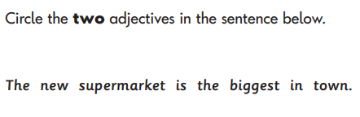
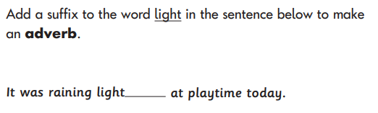
click to see all text
Grammar, Punctuation and Spelling
Grammar, Punctuation and Spelling Paper 2:Questions
The Reading Test consists of two separate papers:
Paper 1 – Contains a selection of texts totalling between 400 and 700 words with questions about the text.
Paper 2 – Contains a reading booklet of a selection of passages totalling 800 to 1100 words. Children will write their answers to questions about the passage in a separate booklet.
Each paper is worth 50% of the marks and should take approximately 30 minutes to complete, although the children are not being assessed at working at speed so will not be strictly timed.
The texts will cover a range of poetry, fiction and non-fiction.
Questions are designed to assess the comprehension and understanding of a child’s reading.
Some questions are multiple choice or selected response, others require
short answers and some require an extended response or explanation.
next page

Slide 20
click to see all text
How to Help Your Child
First and foremost, support and reassure your child that there is nothing to worry about and that they should always just try their best. Praise and encourage!
Ensure your child has the best possible attendance at school.
Support your child with any homework tasks.
Reading, spelling and arithmetic (e.g. times tables) are always good to practise.
Talk to your child about what they have learnt at school and what book(s) they are reading (the character, the plot, their opinion).
If you choose to do so, KS1 practise work books can be purchased, Amazon have a variety to choose from. We recommend CGP books (KS1 assessments Maths and English).
First and foremost, support and reassure your child that there is nothing to worry about and that they should always just try their best. Praise and encourage!
Ensure your child has the best possible attendance at school.
Support your child with any homework tasks.
Reading, spelling and arithmetic (e.g. times tables) are always good to practise.
Talk to your child about what they have learnt at school and what book(s) they are reading (the character, the plot, their opinion).
Make sure your child has a good sleep and healthy breakfast every morning!
next page

Slide 21
click to see all text
How to Help Your Child with Reading
Listening to your child read can take many forms:
First and foremost, focus developing an enjoyment and love of reading.
Enjoy stories together – reading stories to your child is equally as important as listening to your child read.
Read a little at a time but often, rather than rarely but for long periods of time!
Talk about the story before, during and afterwards – discuss the plot, the characters, their feelings and actions, how it makes you feel, predict what will happen and encourage your child to have their own opinions.
Look up definitions of words together – you could use a dictionary, the Internet or an app on a phone or tablet.
All reading is valuable – it doesn’t have to be just stories. Reading can involve anything from fiction and non-fiction, poetry, newspapers, magazines, football programmes, TV guides.
Visit the local library - it’s free!
Listening to your child read can take many forms:
First and foremost, focus developing an enjoyment and love of reading.
Enjoy stories together – reading stories to your child is equally as important as listening to your child read.
Read a little at a time but often, rather than rarely but for long periods of time
Talk about the story before, during and afterwards – discuss the plot, the characters, their feelings and actions, how it makes you feel, predict what will happen and encourage your child to have their own opinions.
Look up definitions of words together – you could use a dictionary, the Internet or an app on a phone or tablet.
All reading is valuable – it doesn’t have to be just stories. Reading can involve anything from fiction and non-fiction, poetry, newspapers, magazines, football programmes, TV guides.
Visit the local library - it’s free!
next page

Slide 22
click to see all text
How to Help Your Child with Writing
Practise and learn weekly spelling lists – make it fun!
Encourage opportunities for writing, such as letters to family or friends, shopping lists, notes or reminders, stories or poems.
Write together – be a good role model for writing.
Encourage use of a dictionary to check spelling.
Allow your child to use a computer for word processing, which will allow for editing and correcting of errors without lots of crossing out.
Remember that good readers become good writers! Identify good writing features when reading (e.g. vocabulary, sentence structure, punctuation).
Show your appreciation: praise and encourage, even for small successes!
Writing will not be assessed with a test but the writing children do at school will be assessed throughout the year and a final judgement will be reported at the end of the academic year.
Practise and learn weekly spelling lists – make it fun!
Encourage opportunities for writing, such as letters to family or friends, shopping lists, notes or reminders, stories or poems.
Write together – be a good role model for writing.
Encourage use of a dictionary to check spelling.
Allow your child to use a computer for word processing, which will allow for editing and correcting of errors without lots of crossing out.
Remember that good readers become good writers! Identify good writing features when reading (e.g. vocabulary, sentence structure, punctuation).
Show your appreciation: praise and encourage, even for small successes!
next page

Slide 23
click to see all text
How to Help Your Child with Maths
Play times tables games.
Play mental maths games including counting in different amounts, forwards and backwards.
Encourage opportunities for telling the time.
Encourage opportunities for counting coins and money e.g. finding amounts or calculating change when shopping.
Look for numbers on street signs, car registrations and anywhere else.
Look for examples of 2D and 3D shapes around the home.
Identify, weigh or measure quantities and amounts in the kitchen or in recipes.
Play games involving numbers or logic, such as dominoes, card games,
draughts or chess.
Play times tables games and use Times Tables Rockstars.
Play mental maths games including counting in different amounts, forwards and backwards.
Encourage opportunities for telling the time.
Encourage opportunities for counting coins and money e.g. finding amounts or calculating change when shopping.
Look for numbers on street signs, car registrations and anywhere else.
Look for examples of 2D and 3D shapes around the home.
Identify, weigh or measure quantities and amounts in the kitchen or in recipes.
Play games involving numbers or logic, such as dominoes, card games,
draughts or chess.
next page

Slide 24
click to see all text
Questions
Play times tables games.
Play mental maths games including counting in different amounts, forwards and backwards.
Encourage opportunities for telling the time.
Encourage opportunities for counting coins and money e.g. finding amounts or calculating change when shopping.
Look for numbers on street signs, car registrations and anywhere else.
Look for examples of 2D and 3D shapes around the home.
Identify, weigh or measure quantities and amounts in the kitchen or in recipes.
Play games involving numbers or logic, such as dominoes, card games,
draughts or chess.
Thank you for taking the time to attend our meeting.
Are there any questions?
next page

